Slide 1

Get In Touch With Us
Himalaya Classification Project
Predicting high altitude mountaineering success rates through data science
Felix Grabscheit
Philipp Kron
Master Data Science WS2019.20
Introduction to Data Science

Slide 2

Data Science Problem
Project Summary
Default risk assessment
Decide if a particular outcome is likely to occur and identify important attributes
Our objective is to predict the likelihood of high altitude mountaineering accidents based on a real world database.
A predictive model is used to calculate individual risks for customers and derive insurance premiums.
The focus is to demonstrate the general use case of data science for insurance rate making purposes.
Data Science Technique
Marketers must link the price to the real and perceived value of the product, but they also must.
Real world application
The method discussed in this project can be used to support risk based decision making processes

Slide 3
Agenda
Refers to a good or service being offered by a company. Ideally, a product should meet a certain consumer demand, or it should be so compelling that consumers believe they need it.
Domain Exploration
Business Opportunity
Data Science in Insurance
Database origin and veracity
Data Exploration
Data extraction and basic modifications
Data cleaning
Descriptive Statistics

Slide 4
Data Preparation
Marketers must link the price to the real and perceived value of the product, but they also must
Modeling
Marketers must link the price to the real and perceived value of the product, but they also must
Model evaluation
Marketers must link the price to the real and perceived value of the product, but they also must
Results interpretation
Marketers must link the price to the real and perceived value of the product, but they also must take into account supply costs.

Slide 5

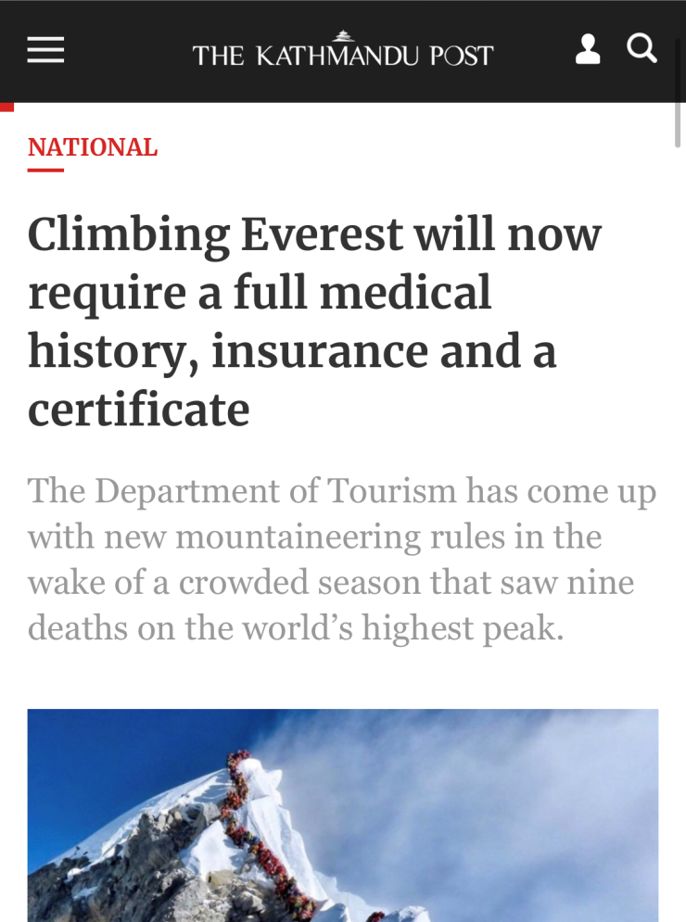

Business Opportunity
Title One
Refers to a good or service being offered by a company. Ideally, a product should meet a certain consumer demand, or it should be so compelling that consumers believe they need it. But they also must take into account supply costs.
The goal of business executives is to get their products in front of the consumers who are most likely to buy them.
https://kathmandupost.com/2/2019/12/15/climbing-everest-will-now-require-a-full-medical-history-insurance-and-a-certificate

Slide 6
Data Science in Insurance
Price optimization
Fraud detection
Comparing competition premiums and customer price sensitivity allows for better premiums
management
Help recognize fraud schemes by detecting suspicious claim patterns and behavior.
Actuary vs Data Science Marketers must link the price to the real and perceived value of the product, but they also must take into account supply costs, seasonal discounts, and prices used by competitors. In some cases, business executives. Place decisions outline where the product is sold and how it is delivered to the market.
Although many data science applications (customer management, consumer targeting) are similar to other industries, there are a few special applications.
Claims prediction
Risk assessment
Forecasting the height of claims helps charging competitive premiums and speed up settlement
Identify risk reasons and quantification among risk groups to improve profitability
K. Umamaheswari, Role of Data mining in Insurance Industry, COMPUSOFT, June 2014
Notes:
„there are no bad risks only bad pricing“
Price sensitivity: Wo kommt Kunde her, Kündigungsvergangenheit, Reaktion auf Preiserhöhung
https://cloud.google.com/blog/products/gcp/using-machine-learning-for-insurance-pricing-optimization

Slide 7
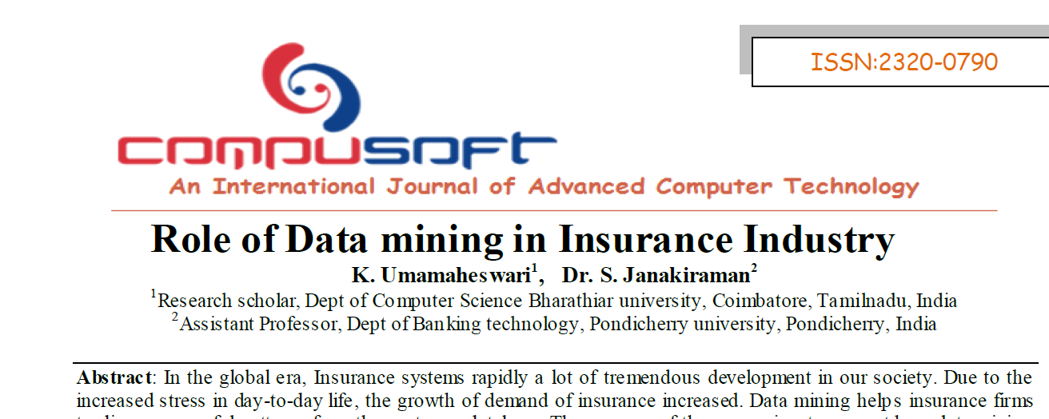
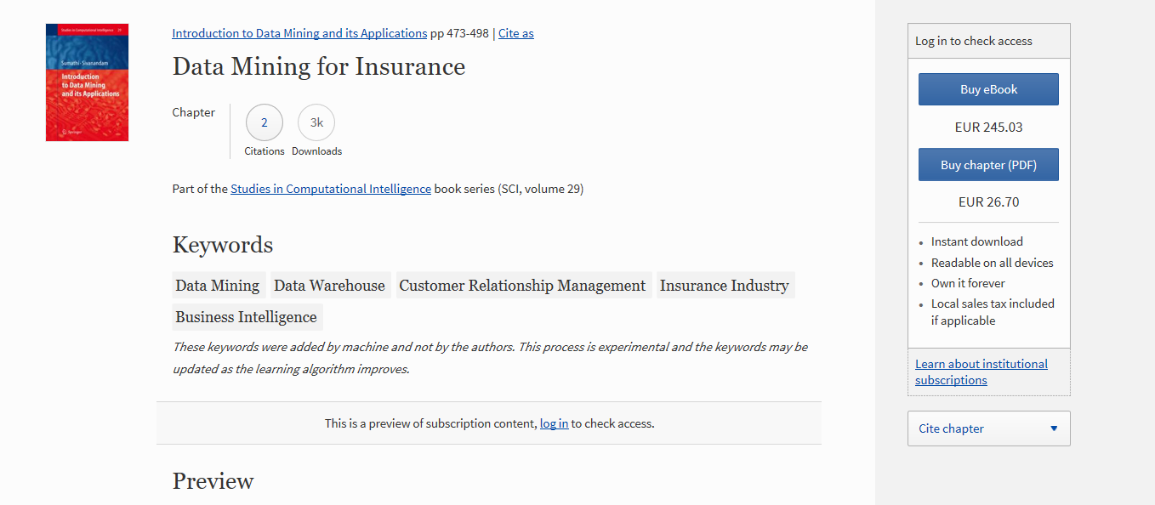

https://www.insurancebusinessmag.com/us/news/breaking-news/insurers-threaten-to-stop-covering-everest-trekkers-123429.aspx

Slide 8
Database origin
Title One
Refers to a good or service being offered by a company. Ideally, a product should meet a certain consumer demand, or it should be so compelling that consumers believe they need it. But they also must take into account supply costs.
The goal of business executives is to get their products in front of the consumers who are most likely to buy them.

Slide 9



Slide 10
Data Veracity
Database depends on correct information from the climbing community. Is the database respected?
Community adoption
Is the data already in use for other scientific research (e.g. high altitude medicine, sports)?
Icon Zeitung
Scientific adoption
Are publicly known ascents/ accidents traceable in the database?
External verification
Notes:
What Is Data Veracity?
Data veracity, in general, is how accurate or truthful a data set may be. In the context of big data, however, it takes on a bit more meaning. More specifically, when it comes to the accuracy of big data, it’s not just the quality of the data itself but how trustworthy the data source, type, and processing of it is. Removing things like bias, abnormalities or inconsistencies, duplication, and volatility are just a few aspects that factor into improving the accuracy of big data.
https://www.gutcheckit.com/blog/veracity-big-data-v/
https://www.bbc.com/news/world-south-asia-10268549

Slide 11

Data Veracity
Database depends on correct information from the climbing community. Is the database respected among climbers?
Community adoption
Is the data already in use for other scientific research (e.g. high altitude medicine, sports)?
Scientific adoption
Are publicly known ascents/ accidents traceable in the database?
External verification
Notes:
What Is Data Veracity?
Data veracity, in general, is how accurate or truthful a data set may be. In the context of big data, however, it takes on a bit more meaning. More specifically, when it comes to the accuracy of big data, it’s not just the quality of the data itself but how trustworthy the data source, type, and processing of it is. Removing things like bias, abnormalities or inconsistencies, duplication, and volatility are just a few aspects that factor into improving the accuracy of big data.
https://www.gutcheckit.com/blog/veracity-big-data-v/
https://www.bbc.com/news/world-south-asia-10268549

Slide 12
Data Veracity
Database depends on correct information from the climbing community. Is the database respected?
Community adoption
Is the data already in use for other scientific research (e.g. high altitude medicine, sports)?
Icon Zeitung
Scientific adoption
Are publicly known ascents/ accidents traceable in the database?
External verification
Notes:
What Is Data Veracity?
Data veracity, in general, is how accurate or truthful a data set may be. In the context of big data, however, it takes on a bit more meaning. More specifically, when it comes to the accuracy of big data, it’s not just the quality of the data itself but how trustworthy the data source, type, and processing of it is. Removing things like bias, abnormalities or inconsistencies, duplication, and volatility are just a few aspects that factor into improving the accuracy of big data.
https://www.gutcheckit.com/blog/veracity-big-data-v/
https://www.bbc.com/news/world-south-asia-10268549

Slide 13
Data Veracity
Database depends on correct information from the climbing community. Is the database respected?
Community adoption
Is the data already in use for other scientific research (e.g. high altitude medicine, sports)?
Icon Zeitung
Scientific adoption
Are publicly known ascents/ accidents traceable in the database?
External verification
Notes:
What Is Data Veracity?
Data veracity, in general, is how accurate or truthful a data set may be. In the context of big data, however, it takes on a bit more meaning. More specifically, when it comes to the accuracy of big data, it’s not just the quality of the data itself but how trustworthy the data source, type, and processing of it is. Removing things like bias, abnormalities or inconsistencies, duplication, and volatility are just a few aspects that factor into improving the accuracy of big data.
https://www.gutcheckit.com/blog/veracity-big-data-v/
https://www.bbc.com/news/world-south-asia-10268549

Slide 14
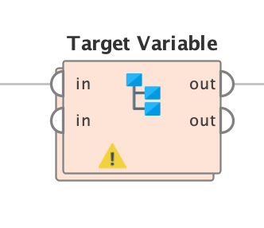
Data Exploration
Export and Import Process
Data Cleaning and Renaming
Deskriptive Analytics
Data Exploration
Export from Java Application
Creating RapidMiner Import-Subprocess
For better understanding in Data Mining Process

Slide 15
Data Preparation
Discretize
Age & Height
Climber Experience
Variable Preselection
Target variable
Reduce variance in certain attributes
Refers to a good or service being offered by a company.
Generate and prepare ???
Refers to a good or service being offered by a company.

Slide 16
Age Groups
Refers to a good or service being offered by a company. Ideally, a product should meet a certain consumer demand, or it should be so compelling that consumers believe they need it.
Climber Experience
Refers to a good or service being offered by a company. Ideally, a product should meet a certain consumer demand, or it should be so compelling that consumers believe they need it.

Slide 17
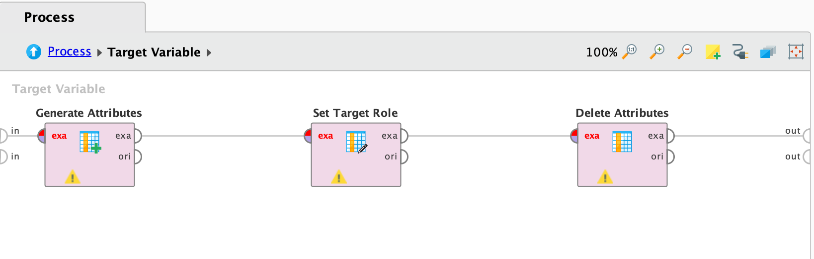
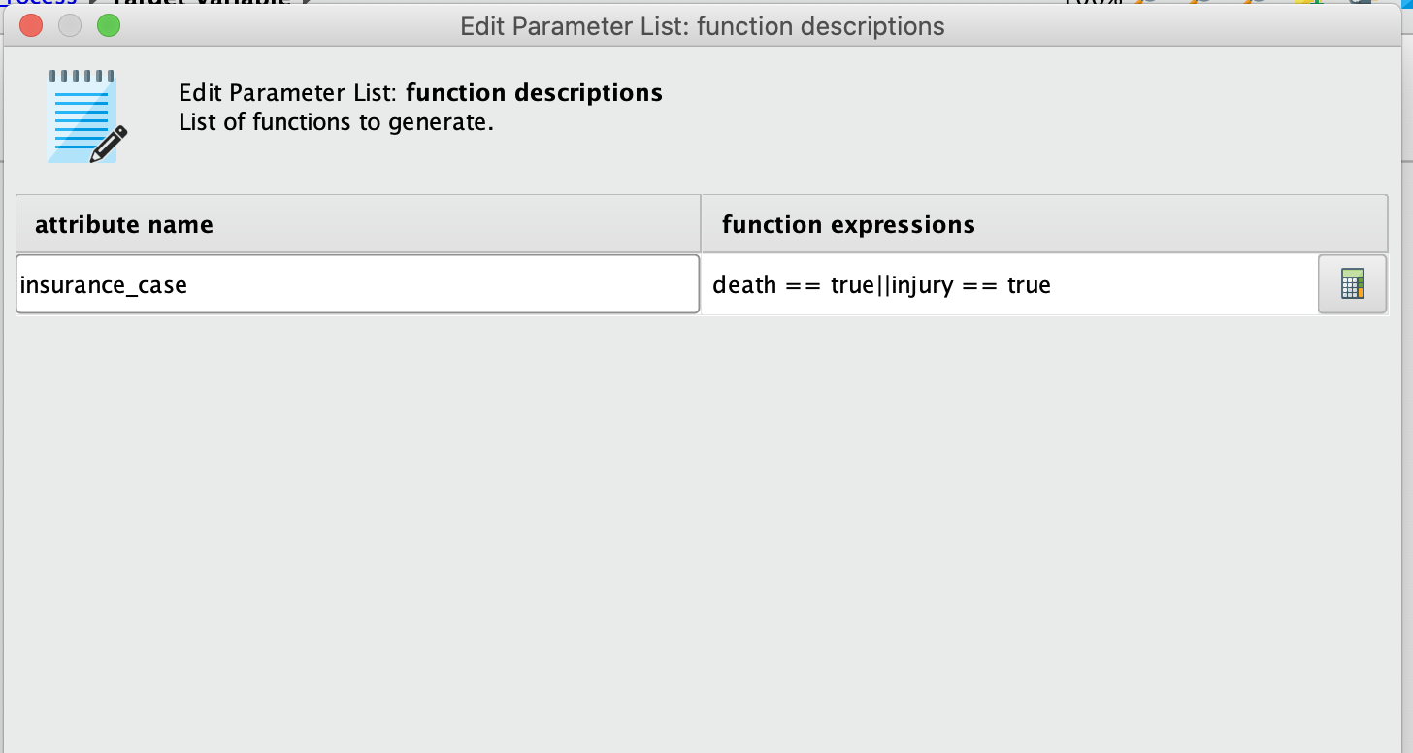
Target variable (insurance_case)
- Combine case of death or injury to insurance_case
- Set insurance_case to target variable
- Delete attribute death and injury from dataset to avoid GINI KOEFFIZIENT

Slide 18
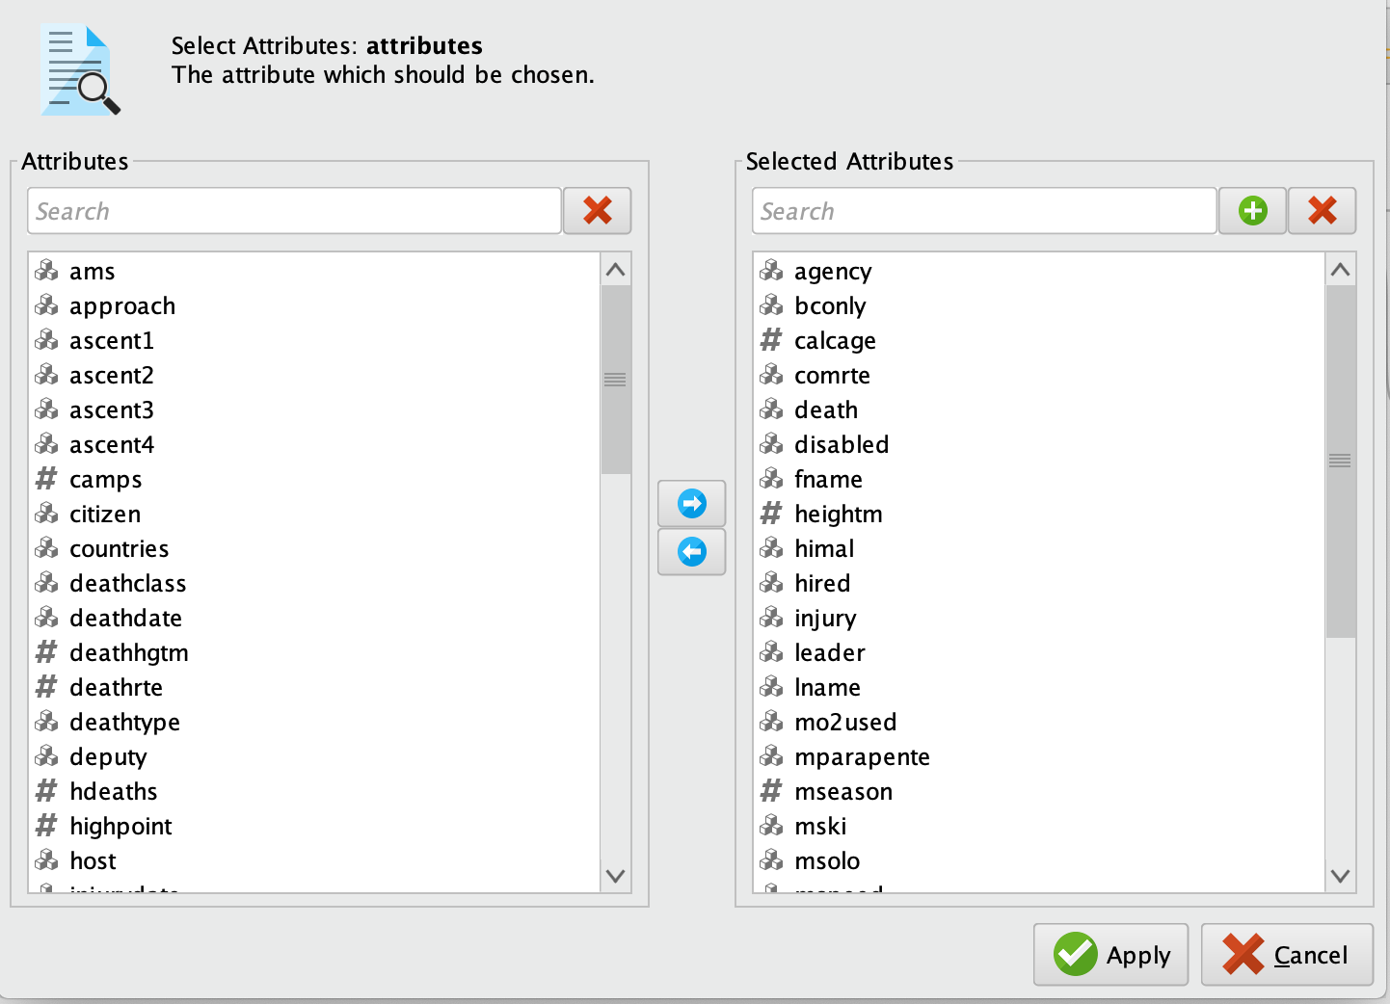
Variable Preselection
- Reduction of unnecessary detail
(e.g. where o2 was used, type of injury or death)
Deletion of redundant information
Deletion of attributes possibly not known to the customer in advance
(e.g. number of ascents, number of hired Sherpa)

Slide 19
Brutto/Netto Prämie
Your Title
Your Title
Service being offered by a company, ideally a product.
Service being offered by a company, ideally a product.
Refers to a good or service being offered by a company
Your Title
Service being offered by a company, ideally a product.
Your Title
Service being offered by a company, ideally a product.
Your Title
Service being offered by a company, ideally a product.

Slide 20
Cases
15%
75%
40%
60%
Title One
Title Two
Title Three
Title Four
Refers to a good or service being offered by a company.
Refers to a good or service being offered by a company.
Refers to a good or service being offered by a company.
Refers to a good or service being offered by a company.

Slide 21
About Us
Marketers must link the price to the real and perceived value of the product, but they also must.

Slide 22
A Welcome Wear
Ben Robertson
The type of product also partially dictates how much businesses. In some cases, business executives may manipulate a price to make a product seem more like a luxury.

Slide 23
A Welcome Wear
Ben Robertson
The type of product also partially dictates how much businesses. In some cases, business executives may manipulate a price to make a product seem more like a luxury.

Slide 24
Our Company Values
Element One
Marketers must link the price to the real and perceived value of the product, but they also a certain consumer demand.
Element Two
Marketers must link the price to the real and perceived value of the product, but they also a certain consumer demand.
Element Three
Marketers must link the price to the real and perceived value of the product, but they also a certain consumer demand.
Element Four
Marketers must link the price to the real and perceived value of the product, but they also a certain consumer demand.

Slide 25
Our Company Values
Title One
Title Two
Title Three
Title Four
Title Five
Refers to a good or service being.
Refers to a good or service being.
Refers to a good or service being.
Refers to a good or service being.
Refers to a good or service being.

Slide 26
Our Company Values
Write Your Title Here
Write Your Title Here
Marketers must link the price to the real and perceived value of the product.
Marketers must link the price to the real and perceived value of the product.
Write Your Title Here
Write Your Title Here
Marketers must link the price to the real and perceived value of the product.
Marketers must link the price to the real and perceived value of the product.

Slide 27
Our Company Values
Title One
Title Two
Title Three
Title Four
Place decisions outline where the product is sold and how it is delivered.
Place decisions outline where the product is sold and how it is delivered.
Place decisions outline where the product is sold and how it is delivered.
Place decisions outline where the product is sold and how it is delivered.

Slide 28
Our Company Values
Title One
The type of product.
Marketers must link the price to the real and perceived value of the product, but they also must take into account supply costs, seasonal discounts, and prices used by competitors. In some cases, business executives. Place decisions outline where the product is sold and how it is delivered to the market.
The goal of business executives is to get their products in front of the consumers who are most likely to buy them.
Title Two
Marketers must link.
Title Tree
Account supply costs.
Title Four
Business executives.

Slide 29
Our Company Values
Title One
Title Two
Title Three
Refers to a good or service being offered by a company.
Refers to a good or service being offered by a company.
Refers to a good or service being offered by a company.

Slide 30
Title One
Our Company Values
The type of product.
Marketers must link the price to the real and perceived value of the product, but they also must take into account supply costs, seasonal discounts, and prices used by competitors. In some cases, business executives. Place decisions outline where the product is sold and how it is delivered to the market.
The goal of business executives is to get their products in front of the consumers who are most likely to buy them.
Title Two
Marketers must link.
Title Tree
Account supply costs.
Title Four
Business executives.

Slide 31
Business Philisophy
Title One
Refers to a good or service being offered by a company. Ideally, a product should meet a certain consumer demand, or it should be so compelling that consumers believe they need it. But they also must take into account supply costs.
The goal of business executives is to get their products in front of the consumers who are most likely to buy them.

Slide 32
Business Philisophy
Title One
Refers to a good or service being offered by a company. Ideally, a product should meet a certain consumer demand, or it should be so compelling that consumers believe they need it. But they also must take into account supply costs.
The goal of business executives is to get their products in front of the consumers who are most likely to buy them.

Slide 33
Company’s Timeline
Title Two
Title Four
Marketers must link the price to the real.
Marketers must link the price to the real.
Title One
Title Three
Marketers must link the price to the real.
Marketers must link the price to the real.

Slide 34
“The future belongs to those who believe in the beauty of their dreams”
— Eleanor Roosevelt
Place decisions outline where the product is sold and how it is delivered to the market. The goal of business executives is to get their products in front of the consumers who are most likely to buy them.

Slide 35
Title One
Refers to a good or service being offered by a company. Ideally, a product should meet a certain consumer demand, or it should be so compelling that consumers believe they need it. But they also must take into account supply costs
Title Two
Refers to a good or service being offered by a company. Ideally, a product should meet a certain consumer demand, or it should be so compelling that consumers believe they need it. But they also must take into account supply costs.

Slide 36
Professional Business & Consulting
Title One
Something about us
The type of product also partially dictates how much businesses. In some cases, business executives may manipulate a price to make a product.
Title Two
Something about us

Slide 37
Title One
Refers to a good or service being offered by a company. Ideally, a product should meet a certain consumer demand, or it should be so compelling that consumers believe they need it. But they also must take into account supply costs
Title Two
Refers to a good or service being offered by a company. Ideally, a product should meet a certain consumer demand, or it should be so compelling that consumers believe they need it. But they also must take into account supply costs.

Slide 38
Professional Business & Consulting
Title One
Something about us
The type of product also partially dictates how much businesses. In some cases, business executives may manipulate a price to make a product.
Title Two
Something about us

Slide 39
Title One
Title Two
Marketers must link the price to the real and perceived value of the product, but they also must take into account supply costs.
Marketers must link the price to the real and perceived value of the product, but they also must take into account supply costs.

Slide 40
Title One
Title Two
Marketers must link the price to the real and perceived value of the product, but they also must take into account supply costs.
Marketers must link the price to the real and perceived value of the product, but they also must take into account supply costs.

Slide 41
Our Mission
“Successful people keep moving. They make mistakes, but they don’t quit.”
Refers to a good or service being offered by a company. Ideally, a product should meet a certain consumer demand, or it should be so compelling that consumers believe they need it.

Slide 42
Meet Our Team
Halie Meagan
John Smith
Katy Mills
Ryan McGill
Marketers must link the price to the real
Marketers must link the price to the real
Marketers must link the price to the real
Marketers must link the price to the real

Slide 43
Meet Our Team
Madison Bruke
The type of product also partially dictates how much businesses. In some cases, business executives may manipulate a price to make a product seem more like a luxury.

Slide 44
Meet Our Team
Amanda Smith
David Nicholson
Marketers must link the price to the real and perceived value.
Marketers must link the price to the real and perceived value.
Madison Bruke
Katy Mills
Marketers must link the price to the real and perceived value.
Marketers must link the price to the real and perceived value.

Slide 45
Meet Our Team
Halie Meagan
Bryan McGill
Ben Anderson
Madison Bruke
Refers to a good or service being offered by a company.
Refers to a good or service being offered by a company.
Refers to a good or service being offered by a company.
Refers to a good or service being offered by a company.

Slide 46
Meet Our Team
Katy Mills
Ryan McGill
Paola Randal's
Service being offered by a company. Ideally, a product should meet a certain.
Service being offered by a company. Ideally, a product should meet a certain.
Service being offered by a company. Ideally, a product should meet a certain.

Slide 47
Meet Our Team
Halie Meagan
Bryan McGill
Ben Anderson
Madison Bruke
Refers to a good or service being offered by a company.
Refers to a good or service being offered by a company.
Refers to a good or service being offered by a company.
Refers to a good or service being offered by a company.

Slide 48
Title One
Refers to a good or service being offered by a company. Ideally, a product should meet a certain consumer demand, or it should be so compelling that consumers believe they need it.
Title Two
Refers to a good or service being offered by a company. Ideally, a product should meet a certain consumer demand, or it should be so compelling that consumers believe they need it.

Slide 49
Title One
Refers to a good or service being offered by a company. Ideally, a product should meet a certain consumer demand, or it should be so compelling that consumers believe they need it.
Title Two
Refers to a good or service being offered by a company. Ideally, a product should meet a certain consumer demand, or it should be so compelling that consumers believe they need it.

Slide 50
Subscribing Plans
Title One
Title Two
$39
Marketers must link the price to the real and perceived value.
$49
Marketers must link the price to the real and perceived value.
Title Three
Title Four
$79
Marketers must link the price to the real and perceived value.
$99
Marketers must link the price to the real and perceived value.

Slide 51
Subscribing Plan
$3240
$435
Place decisions outline where the product is sold and how it is delivered.
Place decisions outline where the product is sold and how it is delivered.
Marketers must link the price to the real and perceived value of the product, but they also must take into account supply costs, seasonal discounts, and prices used by competitors. In some cases, business executives. Place decisions outline where the product is sold and how it is delivered to the market.
The goal of business executives is to get their products in front of the consumers who are most likely to buy them.
$273
$1270
Place decisions outline where the product is sold and how it is delivered.
Place decisions outline where the product is sold and how it is delivered.

Slide 52
Subscribing Plans
$199
The goal of business executives is
$239
Place decisions outline where
$329
Place decisions outline where
$439
The goal of business executives is

Slide 53
Subscribing Plans
$39
$49
$79
$99
Refers to a good or service being offered by a company.
Refers to a good or service being offered by a company.
Refers to a good or service being offered by a company.
Refers to a good or service being offered by a company.

Slide 54
Revenue Model
Marketers must link the price to the real and perceived value of the product, but they also must take into account supply costs, seasonal discounts, and prices used by competitors. In some cases, business executives. To be successful, marketers should understand the life cycle of a product, and business executives should have a plan for dealing with products at every stage of their life cycles.
Title One
Title Two
Title Two
Title Two
47%
24%
24%
24%
Refers to a good or service.
Refers to a good or service.
Refers to a good or service.
Refers to a good or service.

Slide 55
Revenue Model
+120
+70
Refers to a good or service being offered by a company. Ideally, a product should meet a certain consumer demand, or it should be so compelling that consumers believe they need it.
Refers to a good or service being offered by a company.
Refers to a good or service being offered by a company.

Slide 56
Title One
Title Two
Title Two
Title Two
47%
24%
24%
24%
Refers to a good or service.
Refers to a good or service.
Refers to a good or service.
Refers to a good or service.
Revenue Model
Marketers must link the price to the real and perceived value of the product, but they also must take into account supply costs, seasonal discounts, and prices used by competitors. In some cases, business executives. To be successful, marketers should understand the life cycle of a product, and business executives should have a plan for dealing with products at every stage of their life cycles.

Slide 57
Revenue Model
Title One
Title Two
+250
+743
Refers to a good or service.
Refers to a good or service.

Slide 58
Market Validation
+4128
Product should meet a certain consumer demand, or it should be so compelling that consumers believe they need it.
+7390
Product should meet a certain consumer demand, or it should be so compelling that consumers believe they need it.
TITLE A
TITLE B
TITLE C
TITLE D

Slide 59
Market Validation
Marketers must link the price to the real and perceived value of the product, but they also must take into account supply costs, seasonal discounts, and prices used by competitors. In some cases, business executives. To be successful, marketers should understand the life cycle of a product, and business executives should have a plan for dealing with products at every stage of their life cycles. Business executives should have a plan for dealing with products at every stage of their life cycles..
Project One
Project Two
47%
24%
Refers to a good or service.
Refers to a good or service.

Slide 60
Market Validation
+34
+10
+207
+45
Title One
Title Two
Title Three
Title Four
Refers to a good or service being offered by a company.
Refers to a good or service being offered by a company.
Refers to a good or service being offered by a company.
Refers to a good or service being offered by a company.

Slide 61
Market Validation
Marketers must link the price to the real and perceived value of the product, but they also must take into account supply costs, seasonal discounts, and prices used by competitors. In some cases, business executives. To be successful, marketers should understand the life cycle of a product, and business executives should have a plan for dealing with products at every stage of their life cycles. Business executives should have a plan for dealing with products at every stage of their life cycles..
Project One
Project Two
47%
24%
Refers to a good or service.
Refers to a good or service.

Slide 62

Phone
Preview Sample
Title One
Marketers must link the price to the real.
Title Two
Marketers must link the price to the real.

Slide 63
Phone Preview Sample
Title One
Title Two
Marketers must link the price to the real.
Marketers must link the price to the real.

Slide 64
Tablet Preview Sample
Title One
Title Three
Marketers must link the price to the real.
Marketers must link the price to the real.
Title Two
Title Four
Marketers must link the price to the real.
Marketers must link the price to the real.

Slide 65
Phone Preview Sample
Title One
Title Two
Marketers must link the price to the real.
Marketers must link the price to the real.
Marketers must link the price to the real and perceived value of the product, but they also must take into account supply costs, seasonal discounts, and prices used by competitors. In some cases, business executives.

Slide 66

Laptop Preview Sample

Slide 67
Laptop Preview Sample
Your Title
Marketers must link the price to the real and perceived value of the product, but they also must take into account supply costs, seasonal discounts, and prices used by competitors.

Slide 68
Diagram Section
A
B
C
D
Refers to a good or service being offered by a company.
Refers to a good or service being offered by a company.
Refers to a good or service being offered by a company.
Refers to a good or service being offered by a company.

Slide 69
Diagram Section
Mission
Vision
Goals
Values
Strategy
Alive or dead a fish is technically fast
Alive or dead a fish is technically fast
Alive or dead a fish is technically fast
Alive or dead a fish is technically fast
Alive or dead a fish is technically fast

Slide 70
Diagram Section
Your Title
Your Title
Service being offered by a company, ideally, a product.
Service being offered by a company, ideally, a product.
Your Title
Your Title
Service being offered by a company, ideally, a product.
Service being offered by a company, ideally, a product.

Slide 71
Diagram Section
Marketers must link the price to the real and perceived value of the product.
Title One
Marketers must link the price to the real and perceived value of the product.
Title Two
Marketers must link the price to the real and perceived value of the product.
Title Three

Slide 72
Diagram Section
Your Title
Your Title
Marketers must link the price to the real and perceived value.
A
C
Marketers must link the price to the real and perceived value.
Your Title
Your Title
Marketers must link the price to the real and perceived value.
B
D
Marketers must link the price to the real and perceived value.

Slide 73
Diagram Section
A
Write Your Title Here
Refers to a good or service being offered by a company.
B
Write Your Title Here
Refers to a good or service being offered by a company.
C
Write Your Title Here
Refers to a good or service being offered by a company.
Write Your Title Here
D
Refers to a good or service being offered by a company.

Slide 74
Diagram Section
Your Title
Your Title
Your Title
Your Title
Marketers must link the price to the real and perceived value.
Marketers must link the price to the real and perceived value.
Marketers must link the price to the real and perceived value.
Marketers must link the price to the real and perceived value.

Slide 75
Graphic Charts
Title One
Title One
70%
Refers to a good or service being offered by a company.
Title Two
50%
Title Two
Refers to a good or service being offered by a company.
Title Three
90%
Title Three
Refers to a good or service being offered by a company.

Slide 76
Graphic Charts
15%
75%
40%
60%
Title One
Title Two
Title Three
Title Four
Refers to a good or service being offered by a company.
Refers to a good or service being offered by a company.
Refers to a good or service being offered by a company.
Refers to a good or service being offered by a company.

Slide 77
Graphic Charts
60
50
40
30
20
10
0
Title 01
Title 02
Title 03
Title 04
Title 05
Title 06
Title 07

Slide 78
Graphic Charts
90%
85%
65%
50%
40%
Title One
Title Two
Title Three
Title Four
Title Five
A telegraph wire, or a strand of cobweb.
A telegraph wire, or a strand of cobweb.
A telegraph wire, or a strand of cobweb.
A telegraph wire, or a strand of cobweb.
A telegraph wire, or a strand of cobweb.

Slide 79
Graphic Charts
Your Title
Service being offered by a company, ideally a product.
Your Title
Service being offered by a company, ideally a product.
Your Title
Refers to a good or service being offered by a company
Service being offered by a company, ideally a product.
70%
Your Title
Service being offered by a company, ideally a product.
Your Title
Service being offered by a company, ideally a product.

Slide 80
United Estates Editable Map
Title One
Title Two
+98
+480
Refers to a good or service.
Refers to a good or service.

Slide 81
Canada Editable Map
Title One
Title Two
+249
+34
Refers to a good or service.
Refers to a good or service.

Slide 82
Malaysia Editable Map
Title One
Title Two
+614
+70
Refers to a good or service.
Refers to a good or service.

Slide 83
Australia Editable Map
Title One
Title Two
+249
+34
Refers to a good or service.
Refers to a good or service.

Slide 84
China Editable Map
Title One
Title Two
+614
+70
Refers to a good or service.
Refers to a good or service.

Slide 85
Germany Editable Map
Title One
Title Two
+249
+34
Refers to a good or service.
Refers to a good or service.

Slide 87
Get In Touch With Us
Empire State Building
350 5th Ave, New York, NY 10118
(212) 736-3100
Send us a message or visit us. Whenever you like. Refers to a good our service.

Slide 88
thanks

